Slide 1
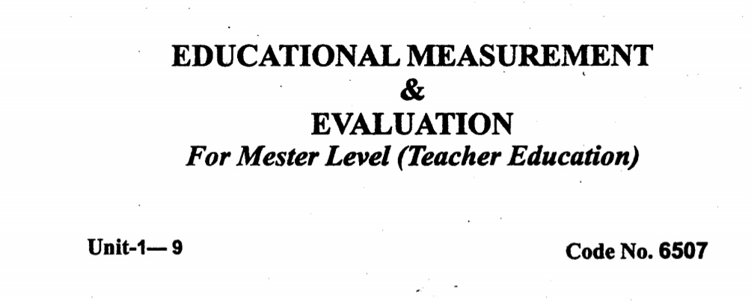

Slide 2
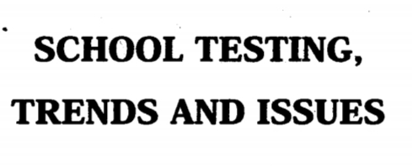
UNIT # 08

Slide 3
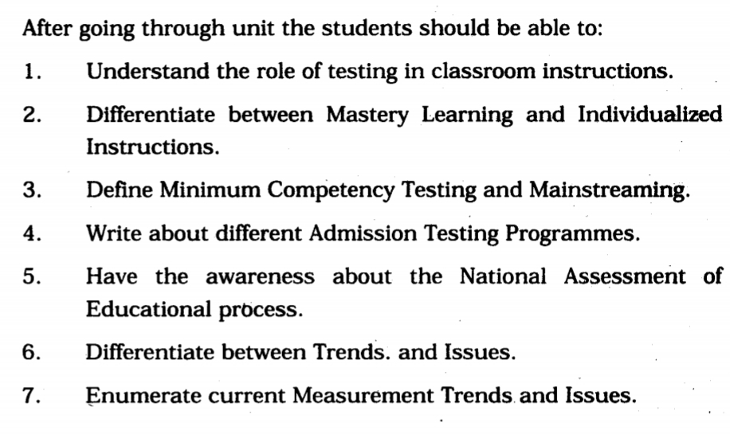
UNIT # 08
OBJECTIVES

Slide 4
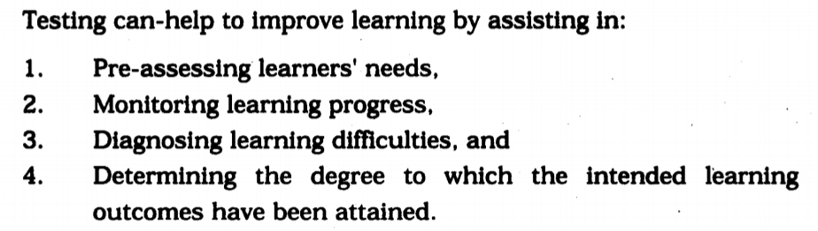
TESTING IN CLASS ROOM

Slide 5
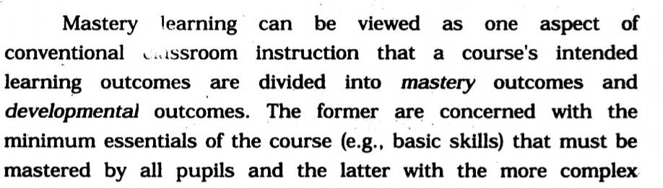
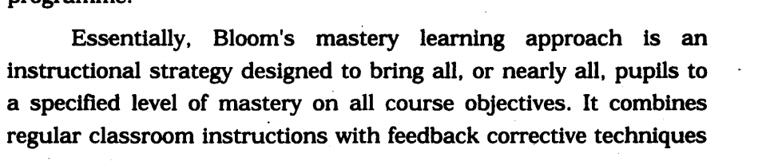
MASTERY LEARNING

Slide 6
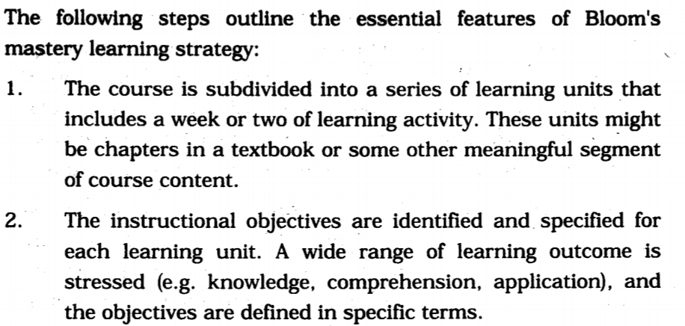
ASSENTIAL FEATURES OF MASTERY

Slide 7
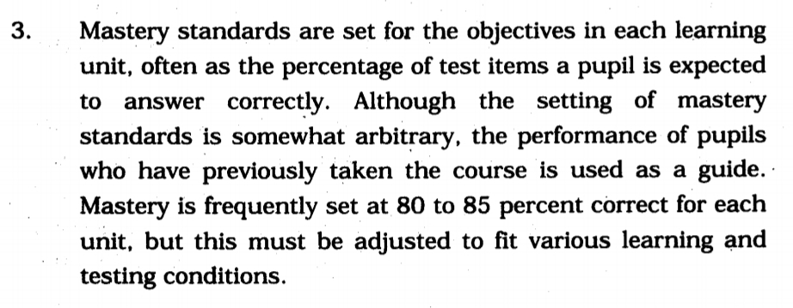
ASSENTIAL FEATURES OF MASTERY

Slide 8
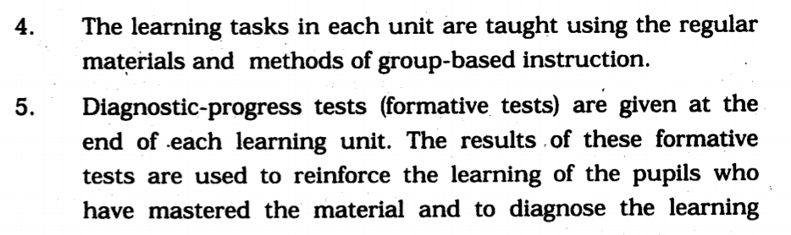
ASSENTIAL FEATURES OF MASTERY

Slide 9
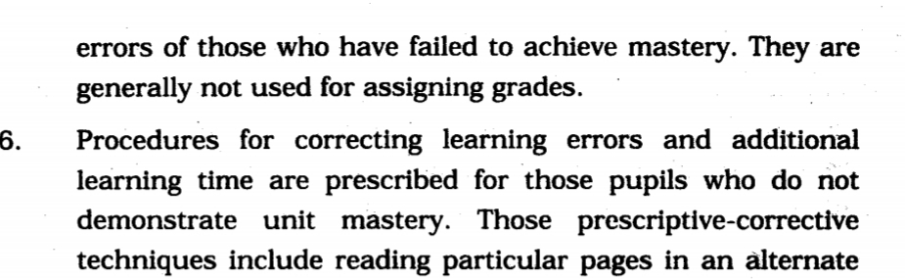
ASSENTIAL FEATURES OF MASTERY

Slide 10
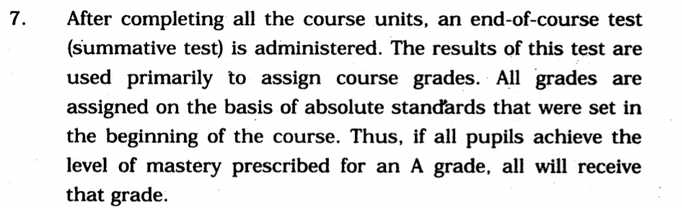
ASSENTIAL FEATURES OF MASTERY

Slide 11
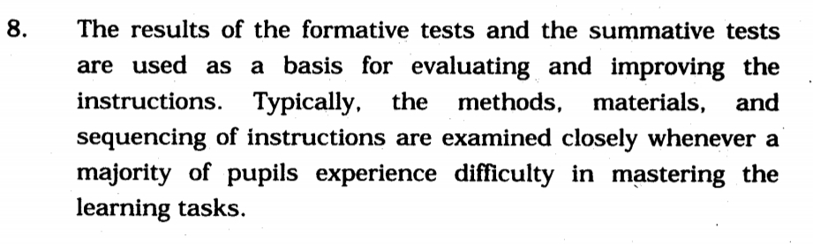
ASSENTIAL FEATURES OF MASTERY

Slide 12
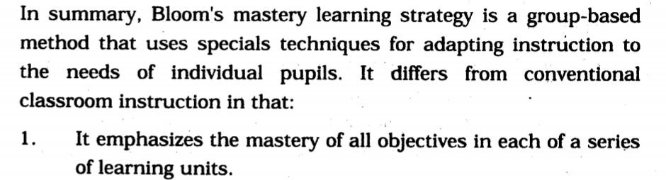
MASTERY VS CONVENTIONAL

Slide 13
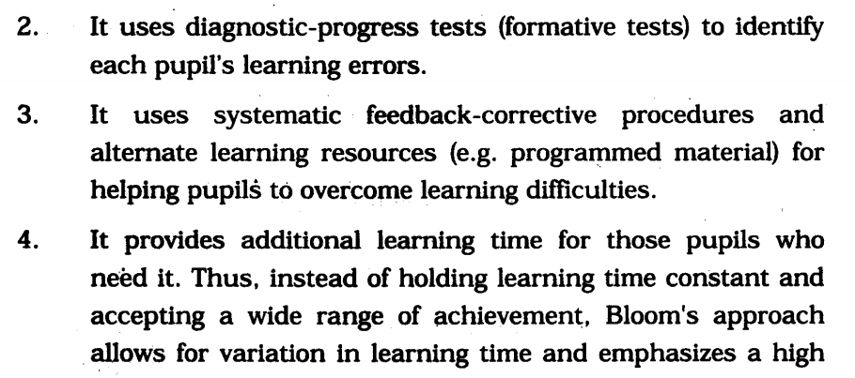
MASTERY VS CONVENTIONAL

Slide 14
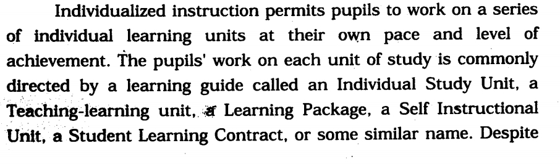
INDIVIDUALIZED INSTRUCTION

Slide 15
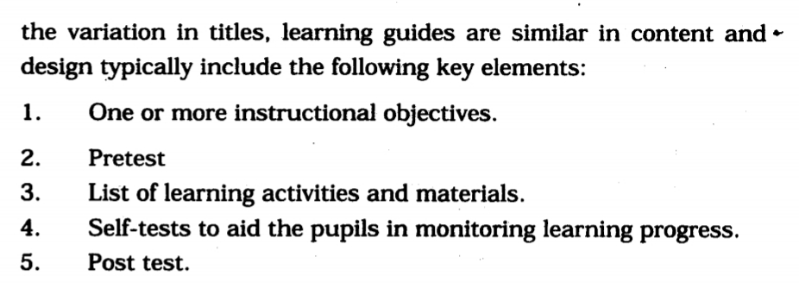
INDIVIDUALIZED INSTRUCTION

Slide 16
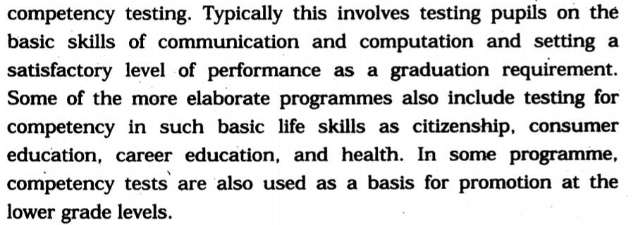
COMPETENCY TTESTING

Slide 17
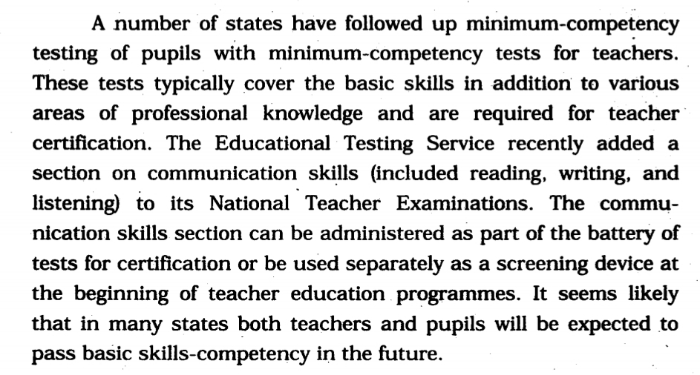
COMPETENCY TTESTING

Slide 18
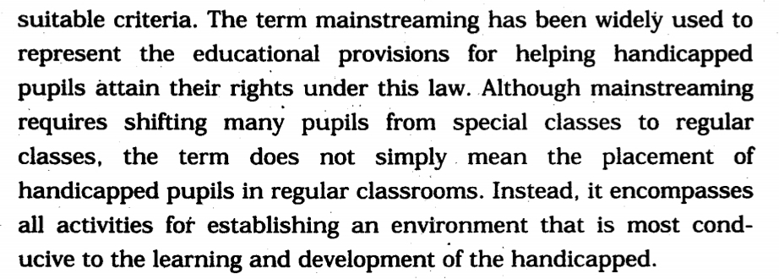
MAINSTREAMING

Slide 19
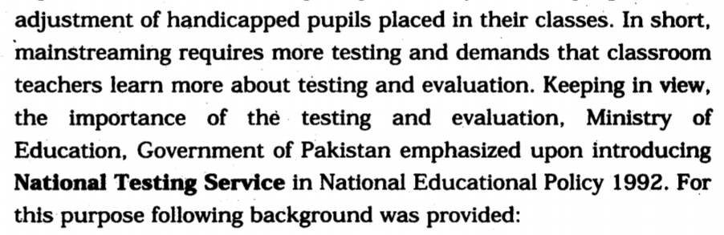
NTS BACKGROUND

Slide 20
NTS BACKGROUND
EVALUATION
IMPLEMENTATION OF EXAMINATION REFORMS
EQUALITY OF QUESTION PAPERS
OBJECTIVE OF EDUCATION
TIME LAG
UGC/IBCC

Slide 21
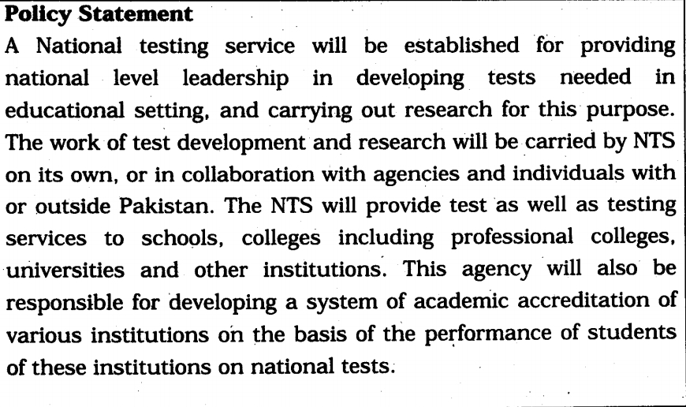
POLICY STATEMENT

Slide 22
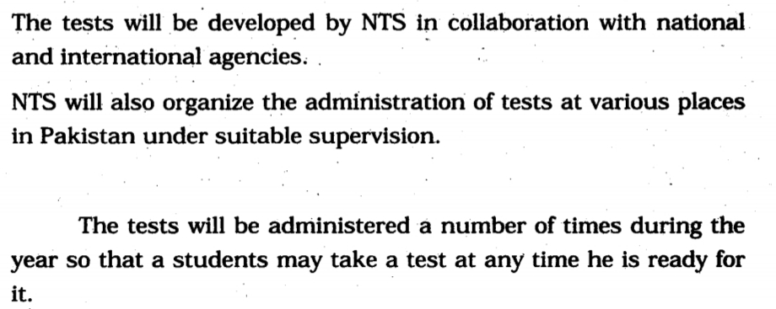
STRATEGY OF NTS

Slide 23
ADMISSION TESTING PROGRAMMES
THERE ARE TWO MAJOR TYPES:
CEEB (COLLEGE ENTRANCE EXAMINATION BOARD )
ACT ( AMERICAN COLLEGE TESTING PROGRAMME )

Slide 24
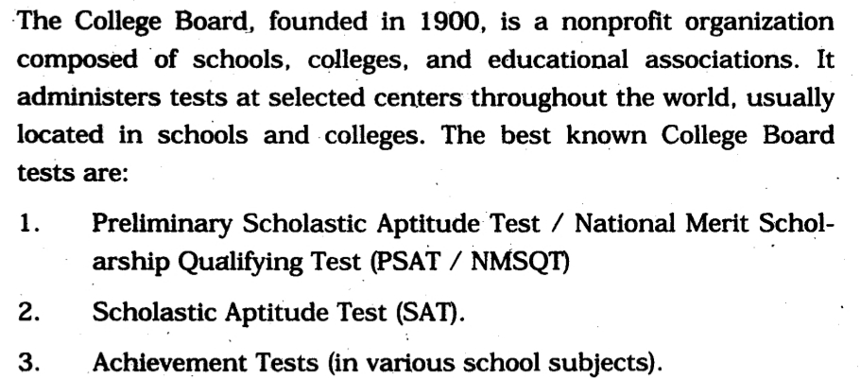
CEEB

Slide 25
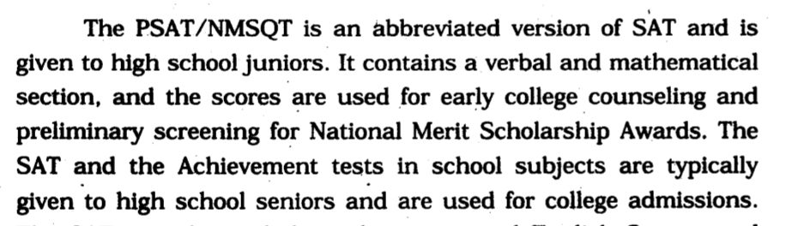
CEEB

Slide 26
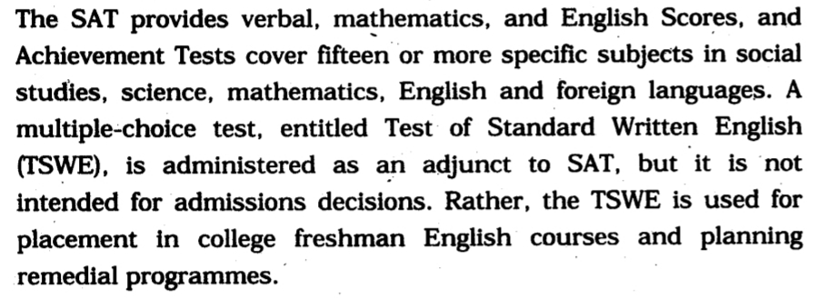
CEEB

Slide 27
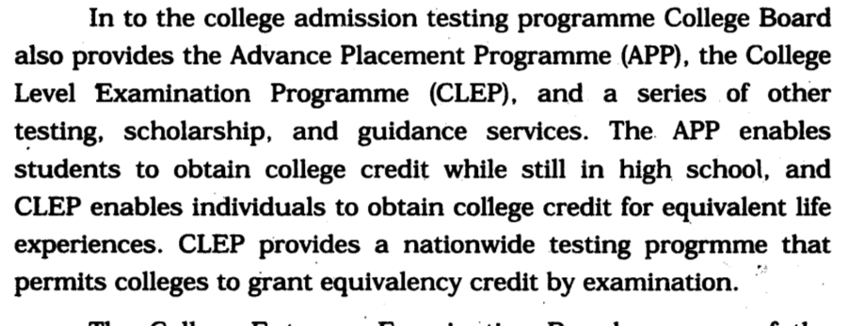
CEEB

Slide 28
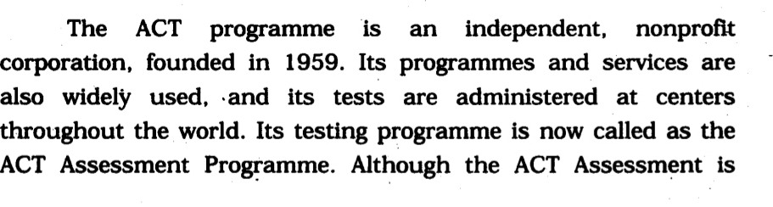
ACT

Slide 29
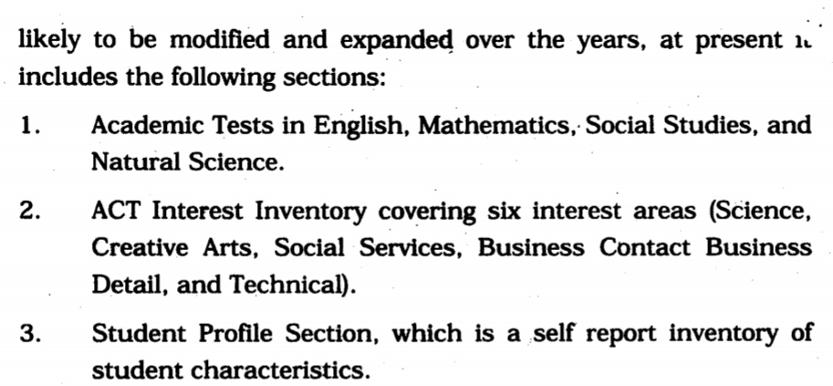
ACT

Slide 30
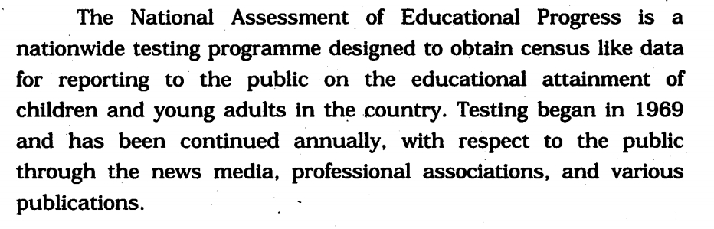
NATIONAL ASSESSMENT OF EDUCATIONAL PROGRESS

Slide 31
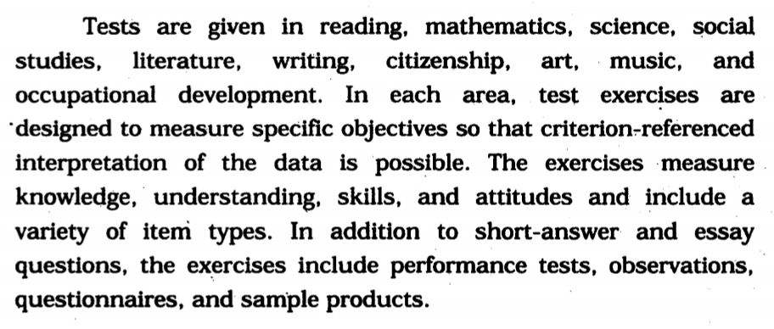
NATIONAL ASSESSMENT OF EDUCATIONAL PROGRESS

Slide 32
MEASUREMENTS,TrENDE, ISSUES
GREATER EMPHISIS ON THE USE OF TEST
CRITERION REFERENCED MEASUREMENT
A SHIFT IN APTITUDE AND ACHIEVEMENT TEST
TYPES OF EXCERCISES BEING USED
USES OF COMPUTERS

Slide 33
MEASUREMENTS,TrENDE, ISSUES
PUBLIC CONCERN ABOUT TESTING
TEST USERS COMPETENCE
PRIVACY AND CONFIDENTIALITY
ASSESSMENT TECHNIQUES

Slide 34
SOCIAL ISSES
BACK GROUND
CULTURAL BIAS IN TESTING
EMPLOYMENT SELECTION
EDUCATIONAL CLASSIFICATION ANF PLACEMENT
SCHOLASTIC APTITUDE TEST
SEX BIAS IN TESTING

Slide 35
CONCERN ISSUES
NATURE AND QUALITY OF TEST
EFFECTS ON STUDENTS
FAIRNES OF TEST TO MINORITIES

Slide 36
EFFECTS ON STUDENTS
CREATE ANXIETY
CATEGORIES AND LEBEL THE STUDENT
DEMAGE STUDENT’S SELF CONCEPTS
CREATE SELF-FULLFILLING PROPFECIS

Slide 37
THANK YOU

